Slide 1
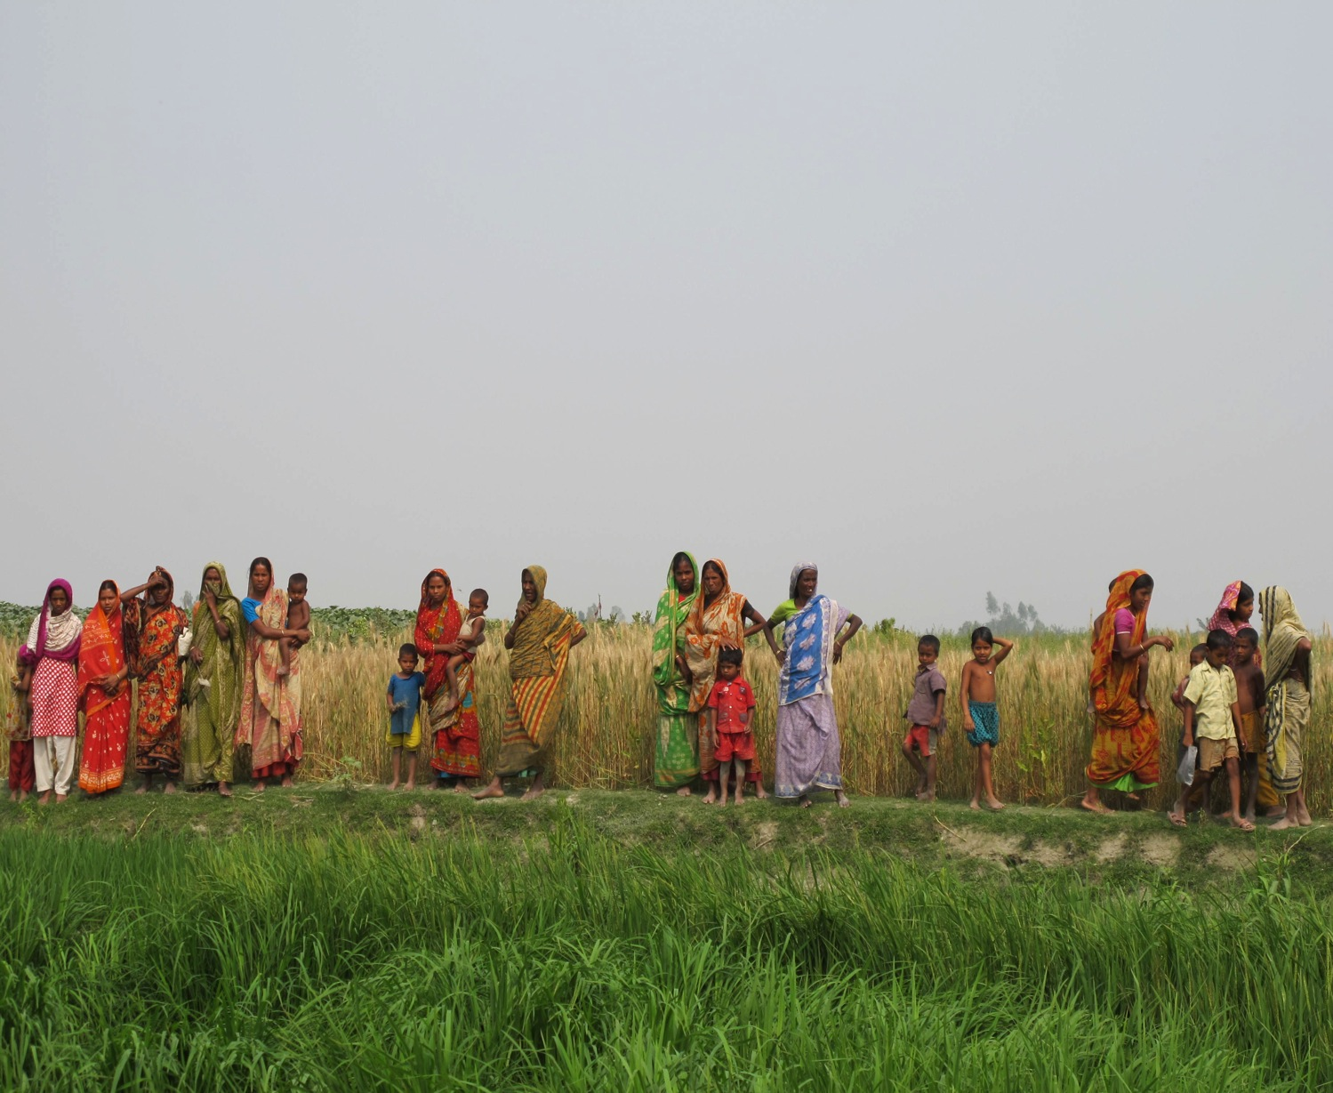
Lessons Learned in Supporting Community Resilience
Reduce Vulnerability
Empower Communities
Understand local risks and vulnerability
Health in all Policies
Invest in translation

