Slide 1
The role for solar and what needs to happen

Slide 2
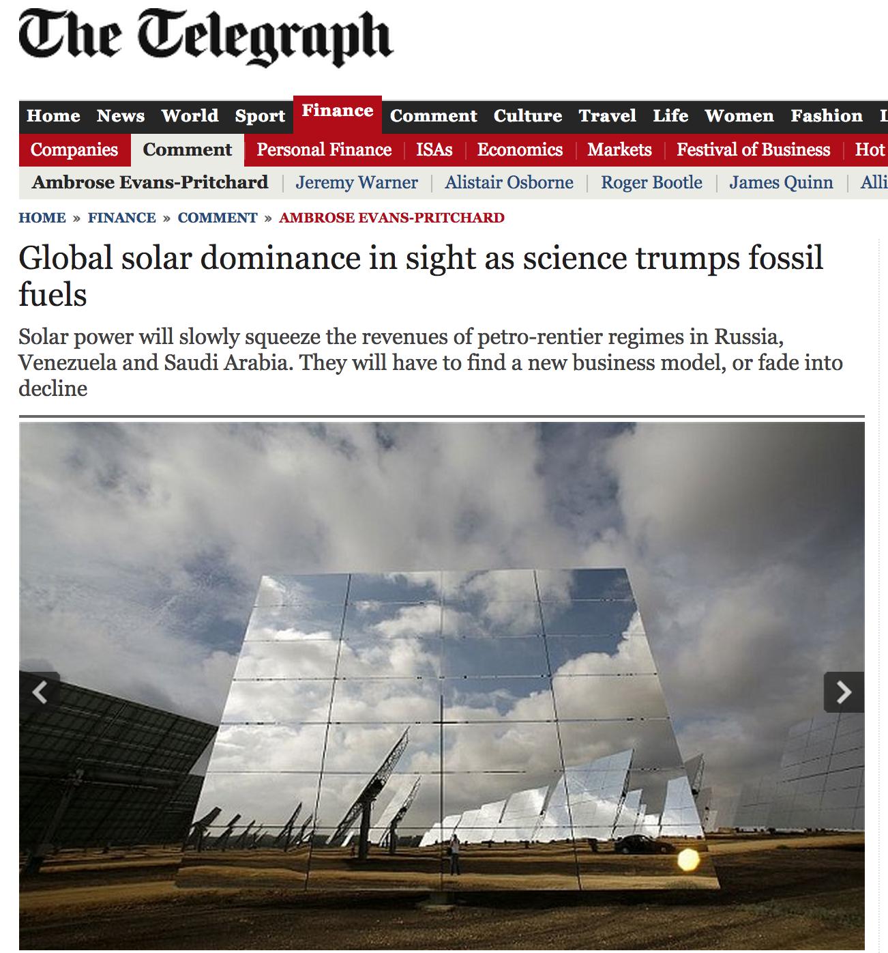
9 April 2014

Slide 3
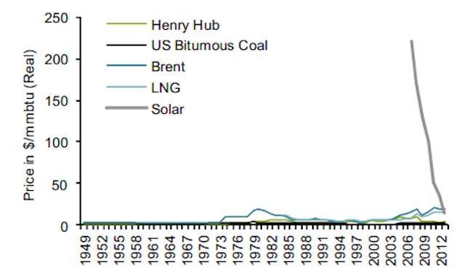
Fossil fuel versus solar: price
Solar PV average
in 2006
35 years
Source: Alliance Bernstein, April 2014

Slide 4
Fossil fuel versus solar: price
2006
The “Terrordome”
Alliance Bernstein, 14 April 2014

Slide 5
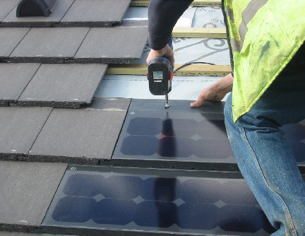
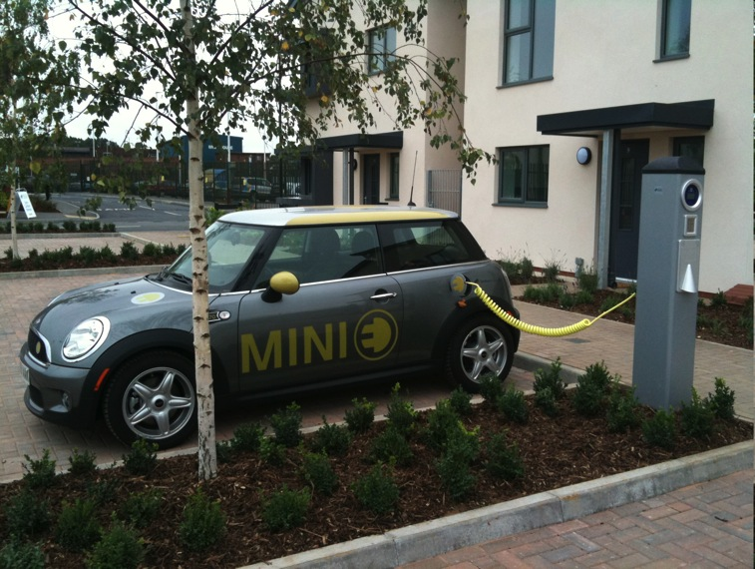
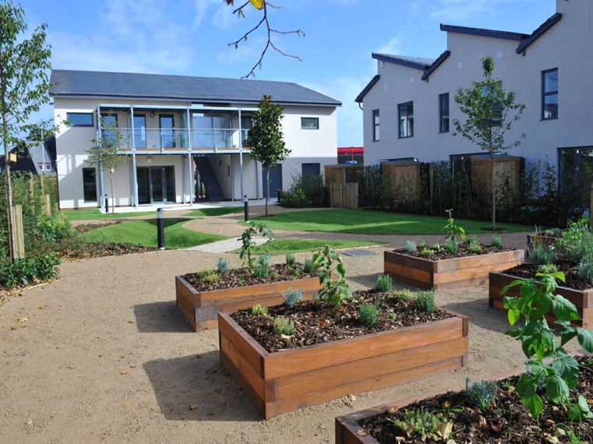
SSE project with Solarcentury rooftiles 2010
Slough, UK

Slide 6
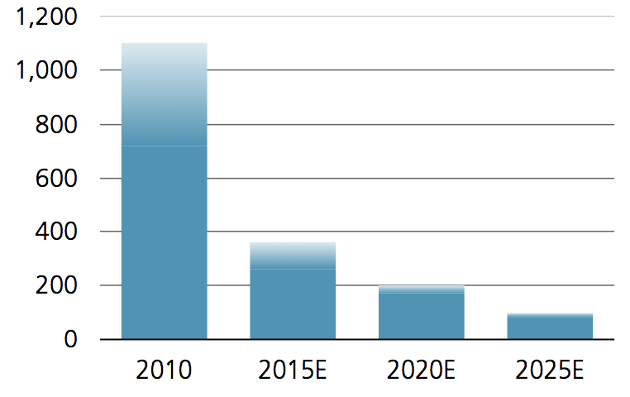
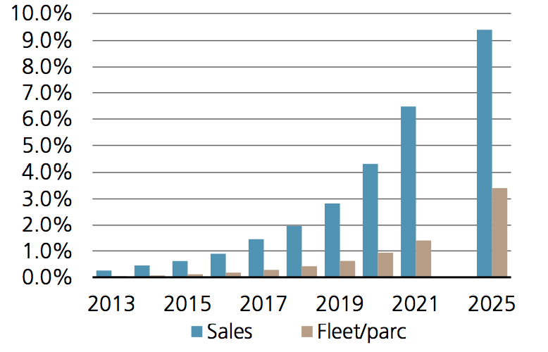
“UBS Urges Investors to Join Solar Revolution”
€ kWh
Lithium battery costs
EU EV sales
EU fleet
Solar PV roof + battery + EV price
Payback, years
ROI
Economics that will revolutionise energy markets
ROI
ROI
27 August 2014

Slide 7
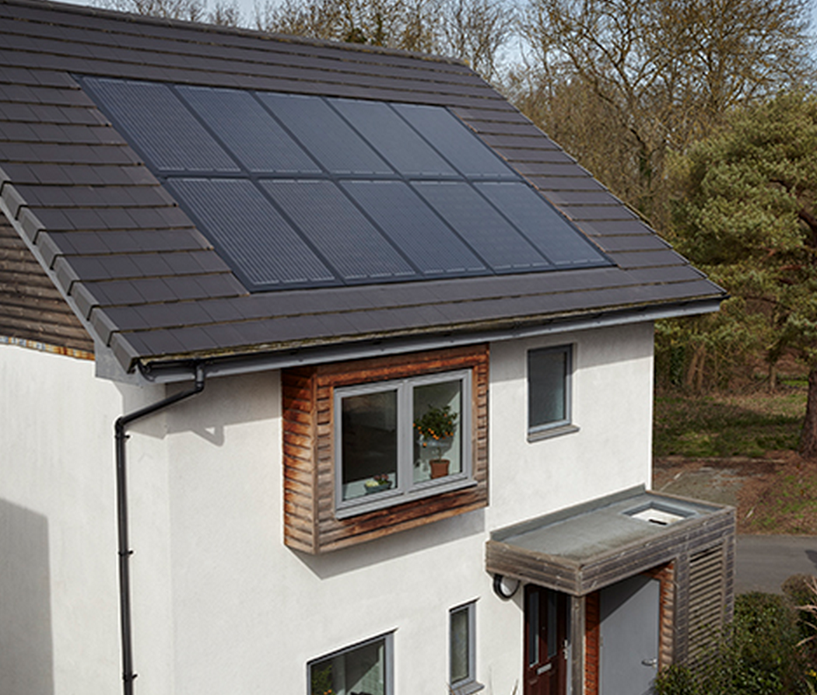
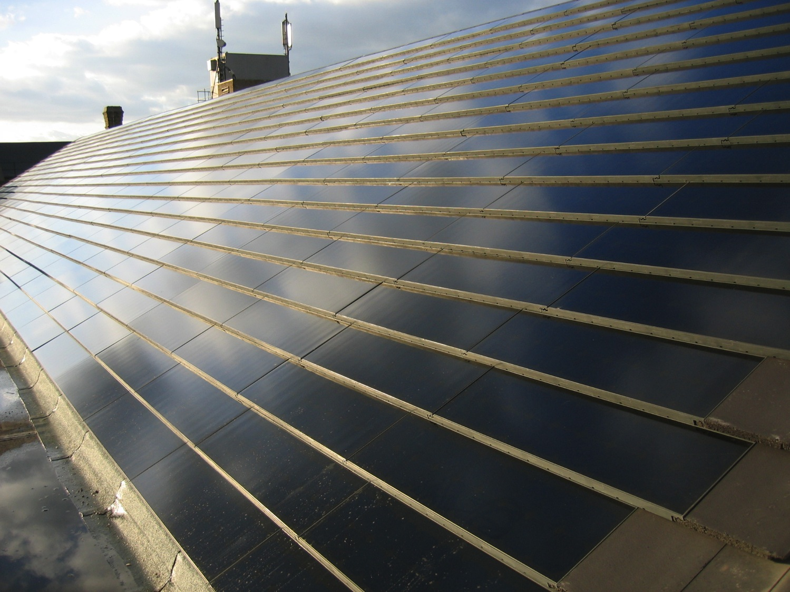
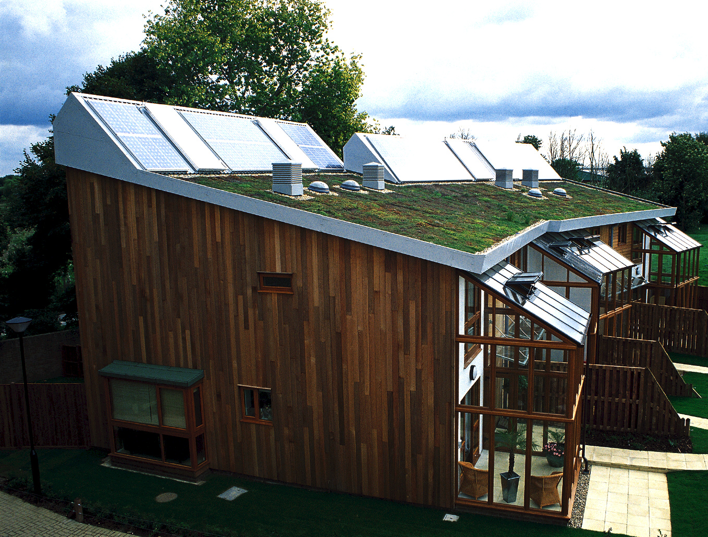
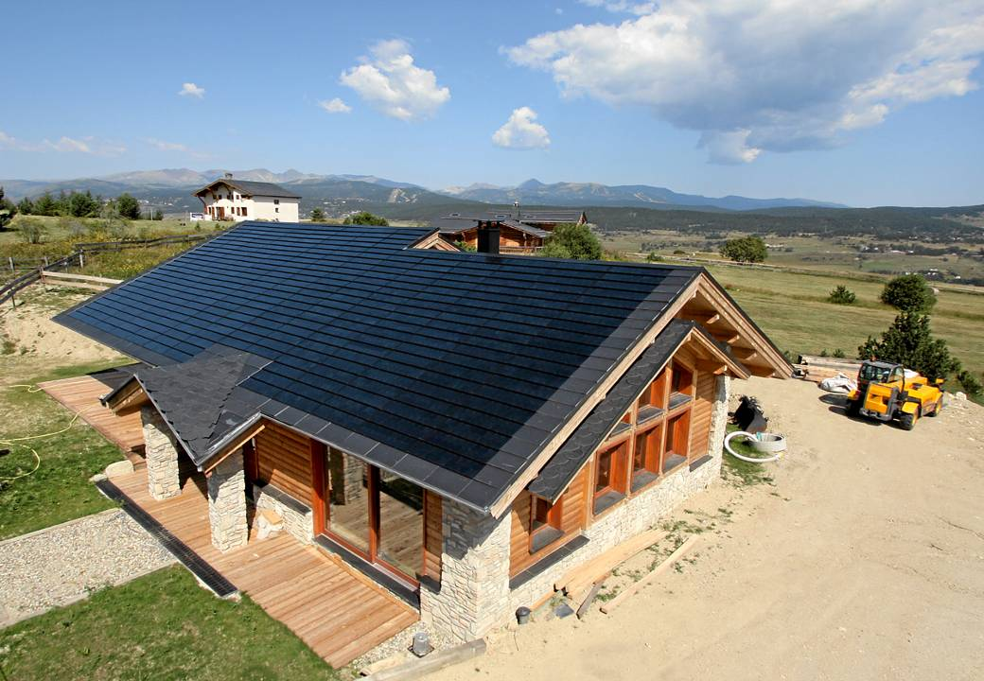
Notes:
JO 733 - C21e + C21t Johnnie Johnson Housing /Southdale Homes

Slide 8
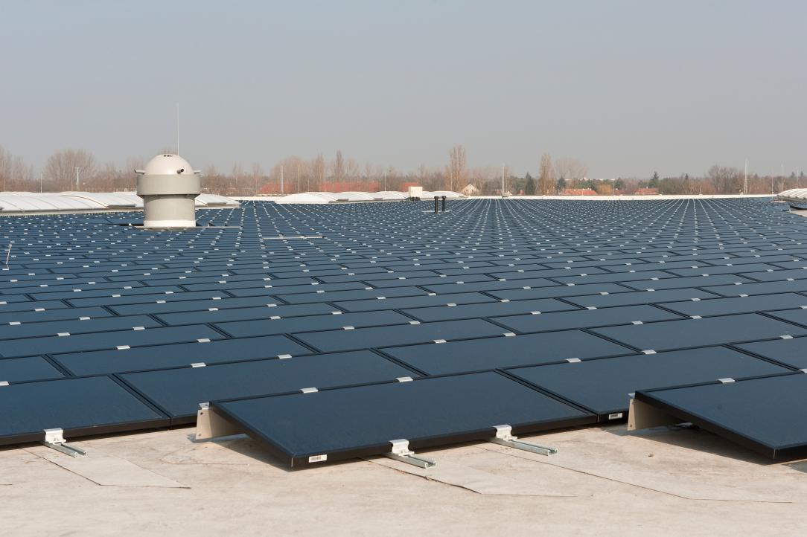
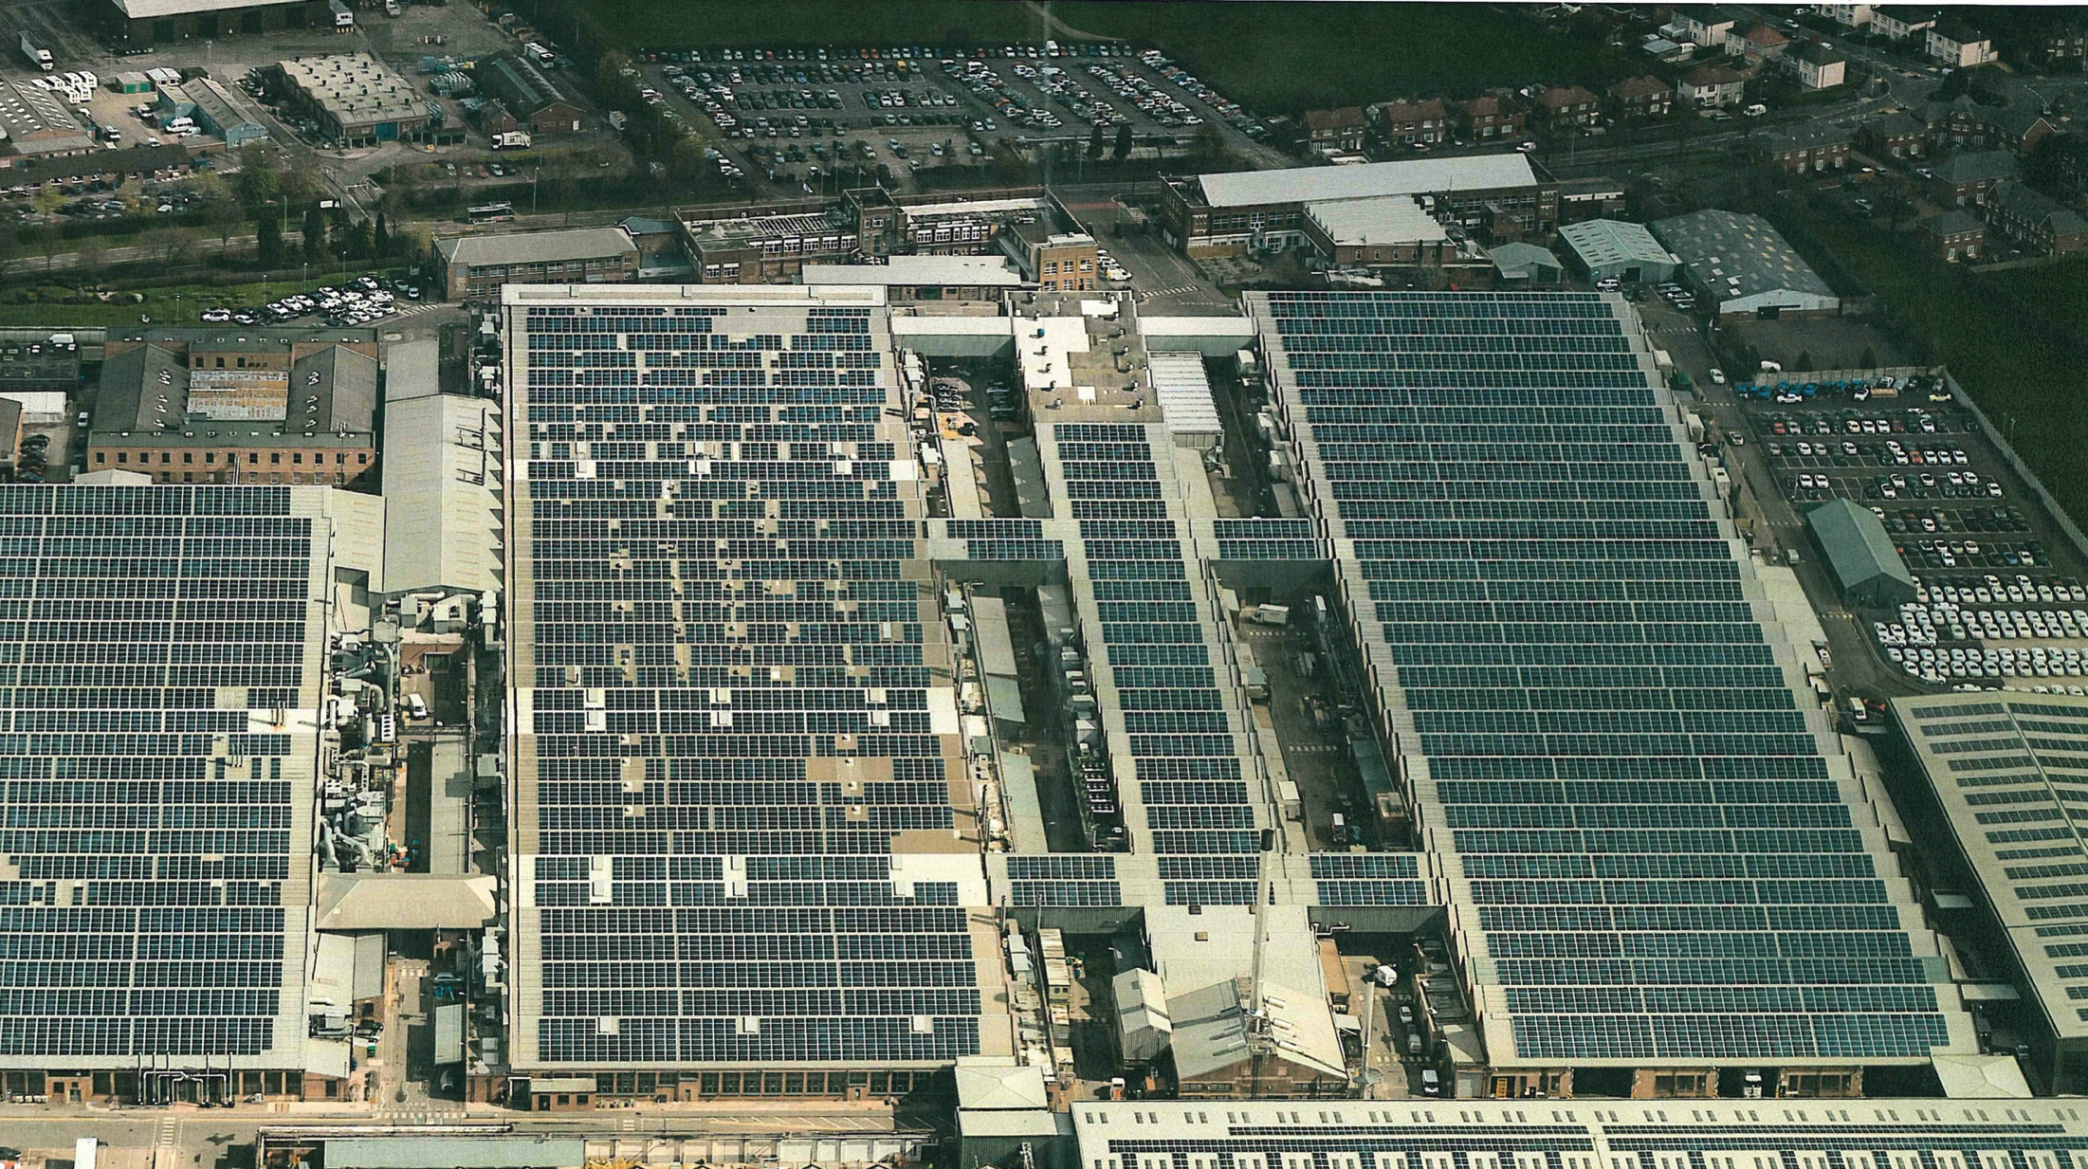
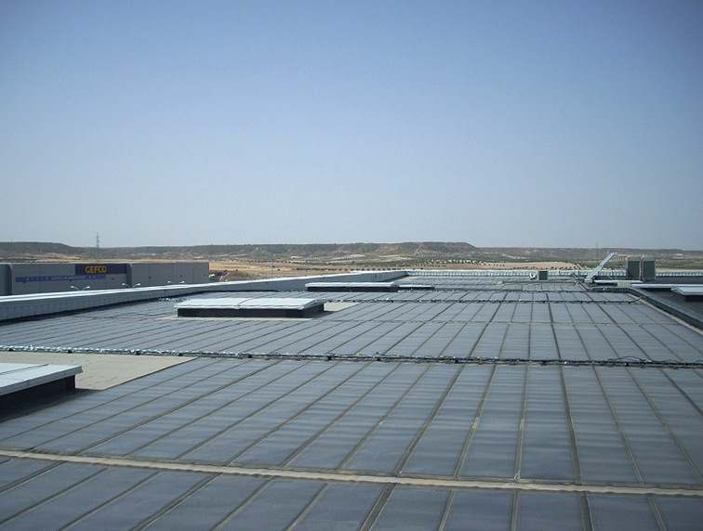
Flat roof

Slide 9
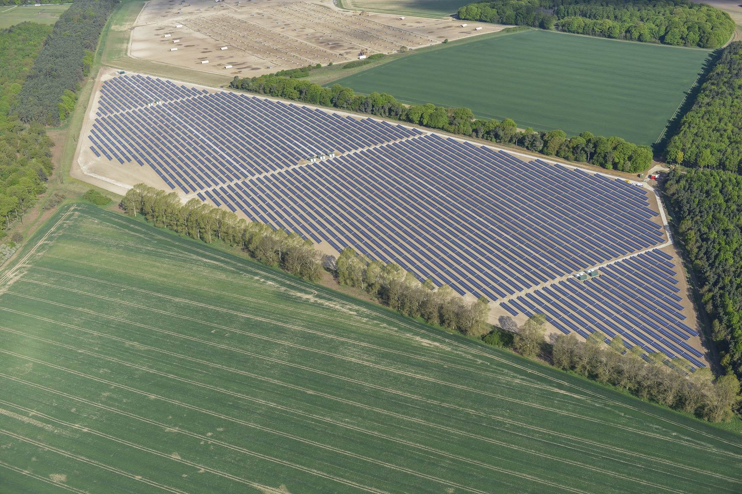
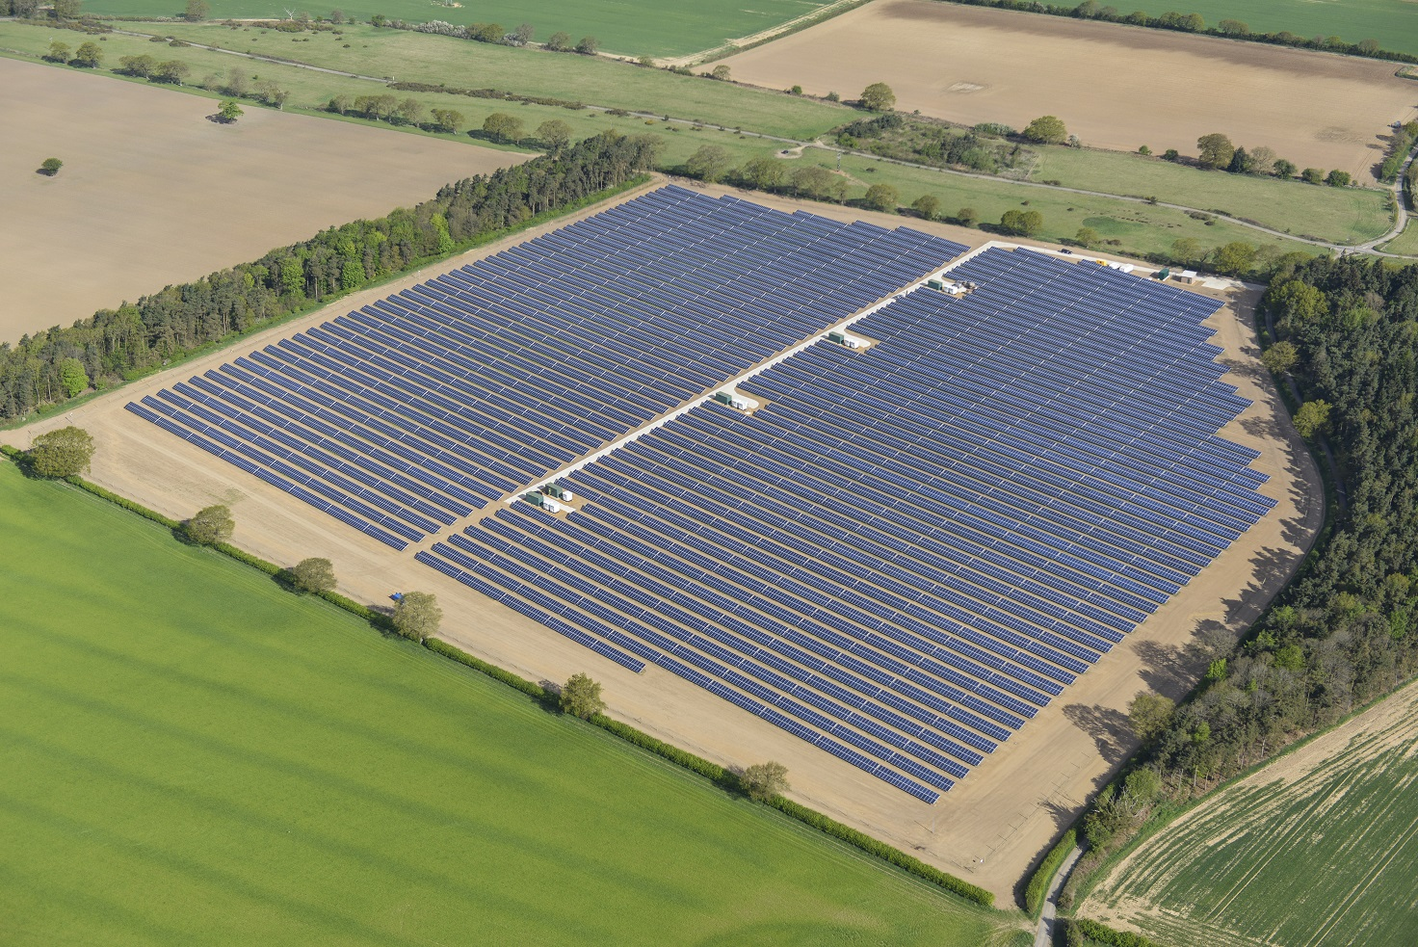
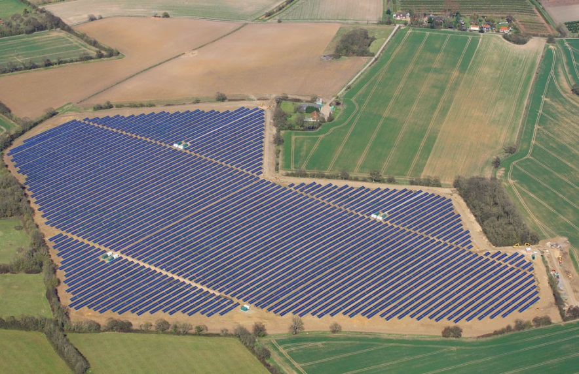

Slide 10
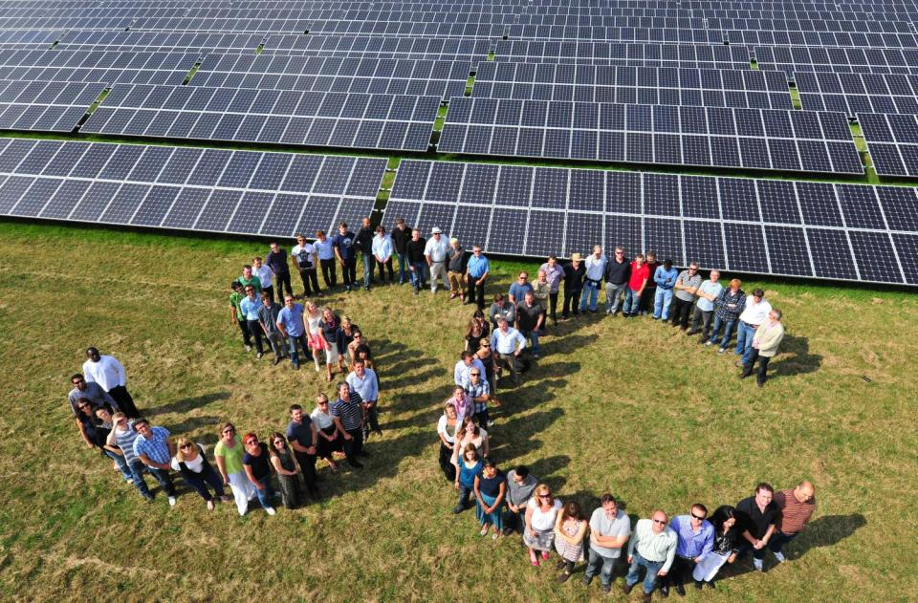
The proposer: SolarAid

Slide 11
Let us not forget….

Slide 12
How to transition out of oil in one easy lesson
in one sector of oil use, on one continent
…but it is a microcosm of the global energy transition

Slide 13
1.7 million sold ….198.3 million to go
$5
Uganda
Malawi
Zambia
Mission set:
to play lead role in ridding Africa of oil use in lighting
Kenya
1st light sold
$25
Tanzania
"Few, if any, other businesses have launched
a sustainable brand and enabled thousands of people
to live more sustainably in such a short space of time”

Slide 14
There is encouraging precedent

Slide 15
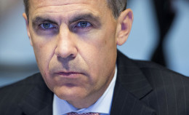
September 30th, 2015
“Climate change is the biggest issue for the future”
Stranded assets:
“..investors must be given the data to “invest accordingly”

Slide 16
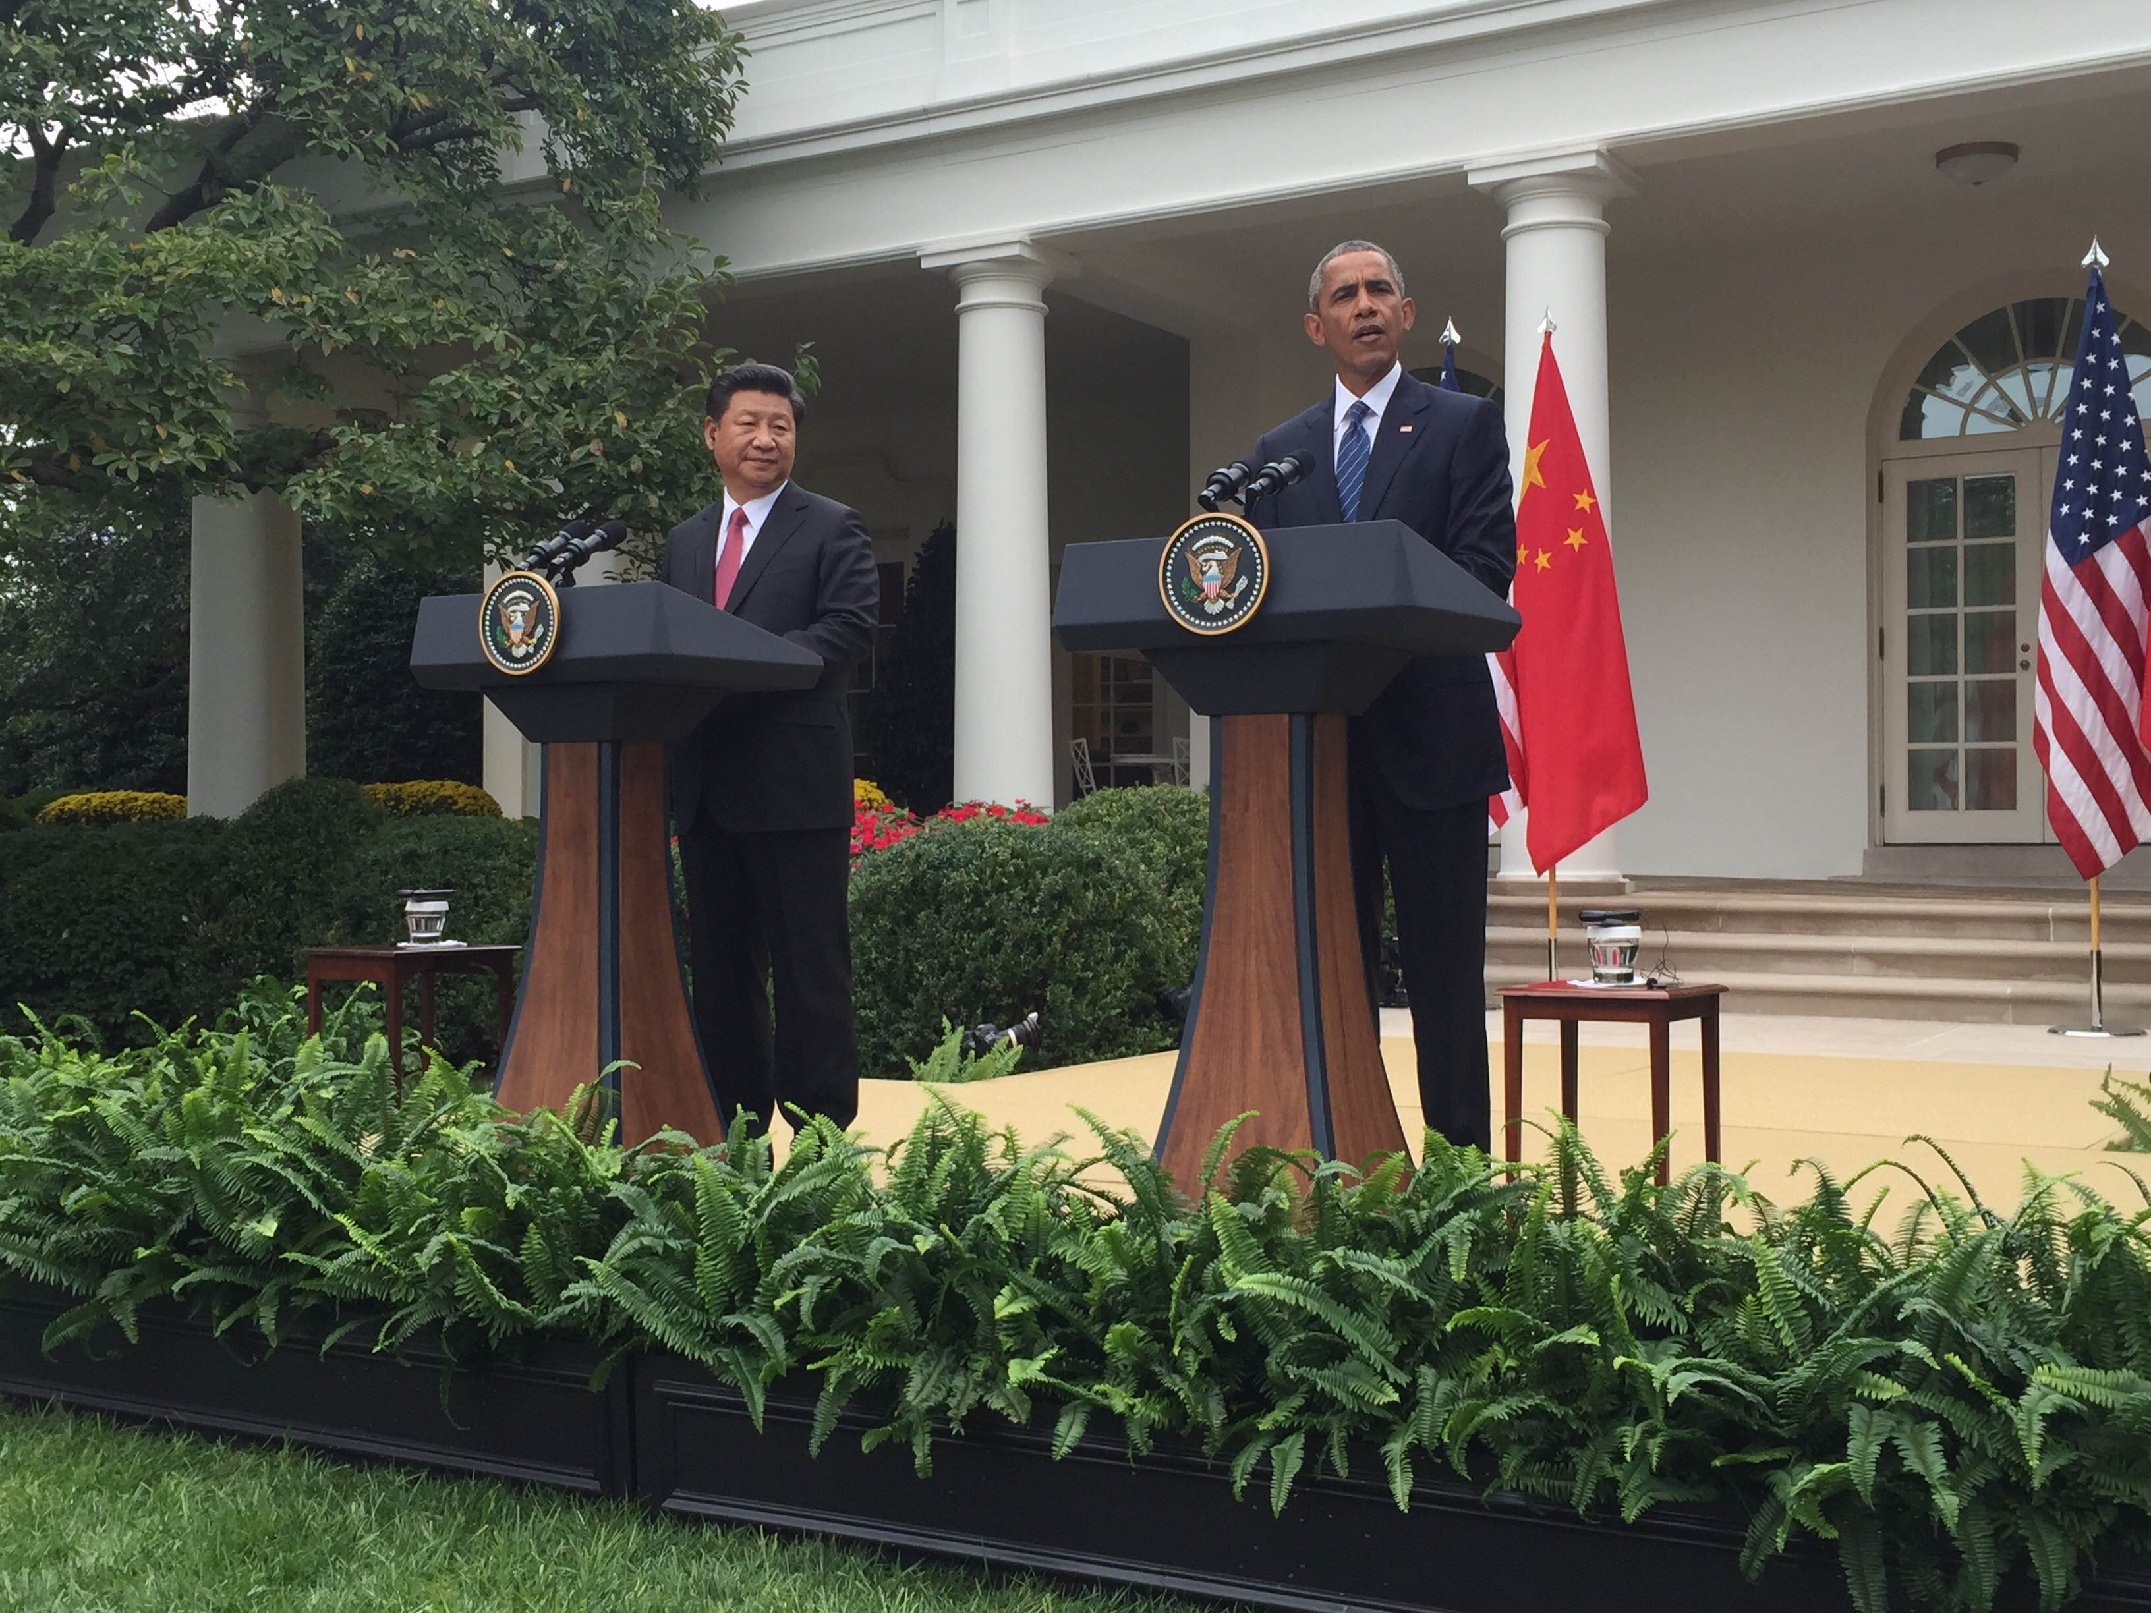
September 25th, 2015
And:
66% of emissions are down to 90 companies

Slide 17
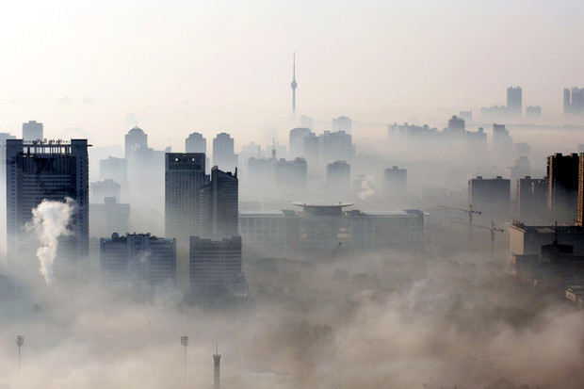
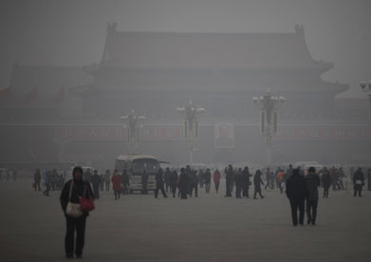
“Coal is in terminal decline”
Goldman Sachs
September 23rd 2015

Slide 18
“Jeremy’s front-line chronicle of events in energy and climate is fascinating”
Richard Branson, Virgin
“I can’t recommend this highly enough …it comes across as a thriller.”
Sami Grover, Treehugger.com
“Daringly funny, starkly terrifying, poetic, personal and intensely urgent”
Josh Fox, Emmy-winning film director
Free download serial
Available on www.jeremyleggett.net

