Slide 1
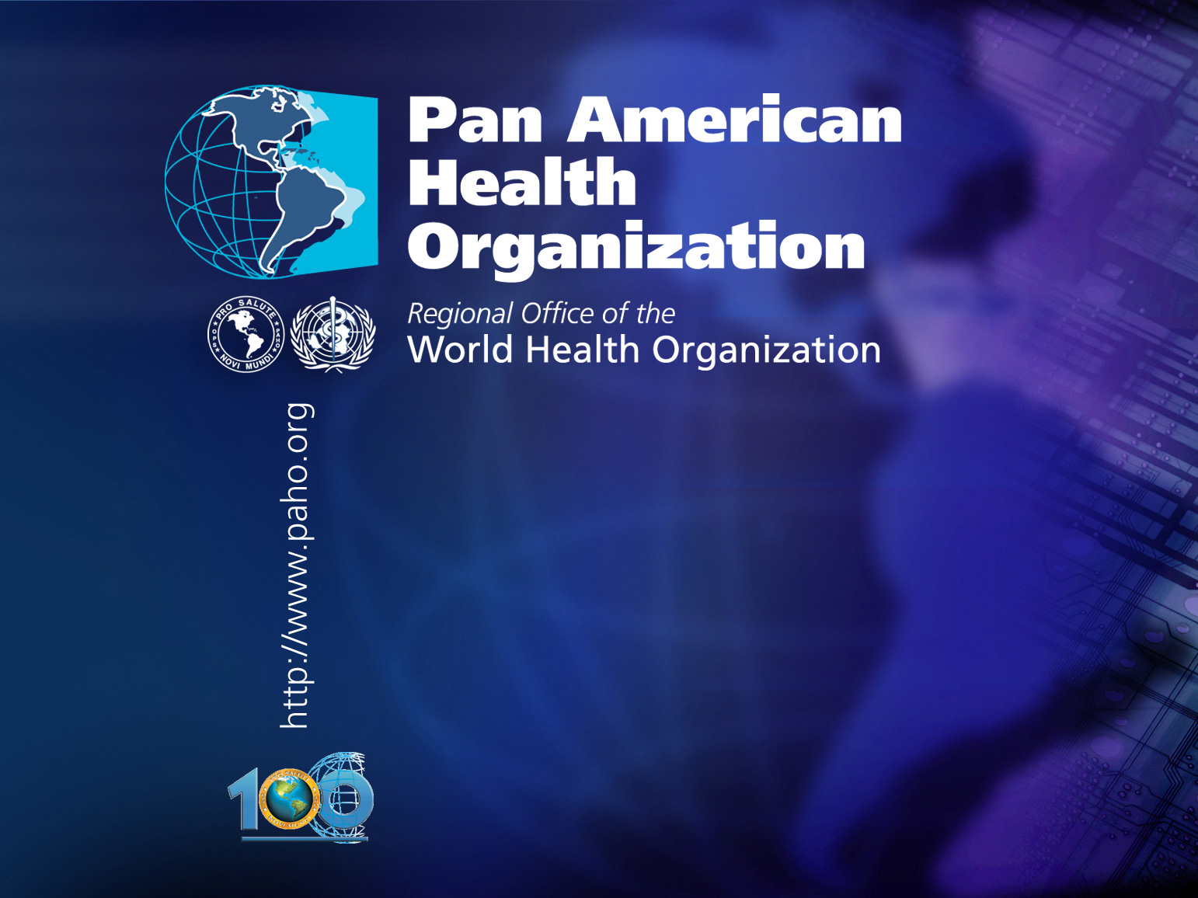
.
.
Ensuring health services function in emergencies
Dr. Ciro Ugarte
Director
Emergency Preparedness
And Disaster Response

Slide 2

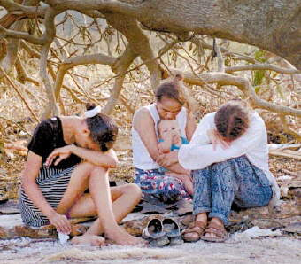

Slide 3
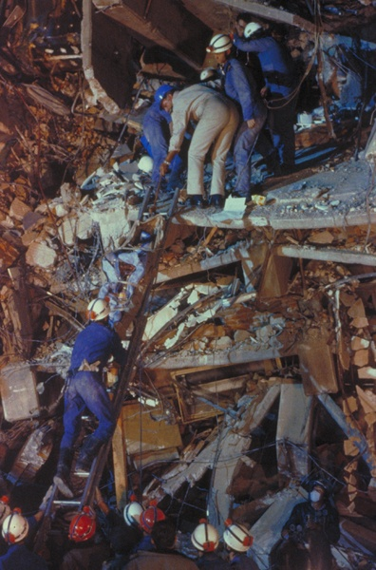
The trigger
The 1985 Mexico earthquake showed that having well prepared hospitals was not enough to cope with disasters.
The ministers of health decided to implement hospital mitigation measures to prevent infrastructure collapse.

Slide 4
















Scientific Publications

Slide 5
The problem
More than 67% of the hospitals are located in high risk areas.
Hospitals are a huge investment and represent close to 70% of the Ministries of Health budget.
Consequence: 45 million people without proper health care and more than 9 billion dollars in direct losses.

Slide 6
From
Vulnerability Reduction in Health Facilities
(1985 – 2004)
to
Safe Hospitals
(2005 – 2015)

Slide 7
From Theory to Practice in the Health Sector
In theory, the health sector should be able to ensure that all health facilities are safe from disasters.
In practice, it is necessary to begin increasing the safety of those health services that are located in high risk areas and that provide essential life-saving health care services.

Slide 8
Levels of Protection
Life Protection (patients, health personnel and visitors)
Investment Protection (equipment, supplies, furniture and utility services)
Operational Protection (facility’s capacity to provide health care).

Slide 9






Regional Meeting
Hospitals in Disasters: Handle with Care
El Salvador, 8-10 July 2003

Slide 10

Adopt “Hospitals Safe from Disasters” as a national risk reduction policy, set the goal that all new hospitals are built with a level of protection that better guarantees their remaining functional in disaster situations,
and implement appropriate mitigation measures to retrofit existing health facilities, particularly those providing primary care.

Slide 11

“Integrate disaster reduction planning in the health sector; Promote the goal of Safe Hospitals to ensure that all new hospitals are built with a level of protection that better guarantees their remaining functional in disaster situations,
and implement appropriate mitigation measures to reinforce existing health facilities, particularly those providing primary care.”
Hyogo Framework for Action 2005–2015:
Building the Resilience of Nations
and Communities to Disasters

Slide 12
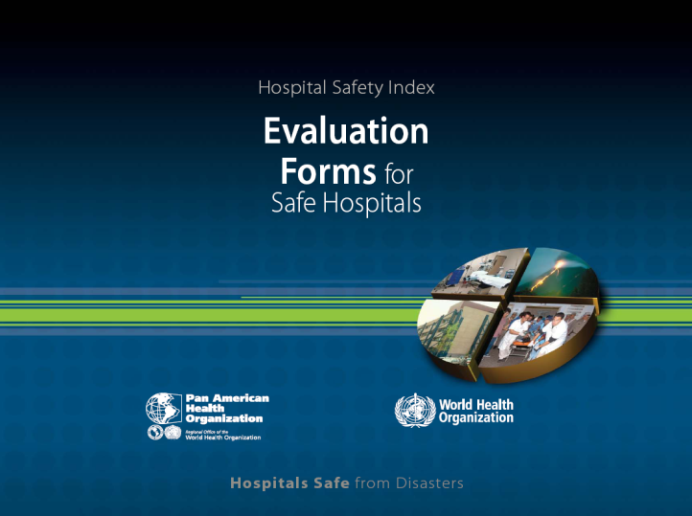
Hospital Safety Index
Safe Hospitals Checklist
Mathematic Model (Safety Index Calculator)
Hospital Safety Index

Slide 13
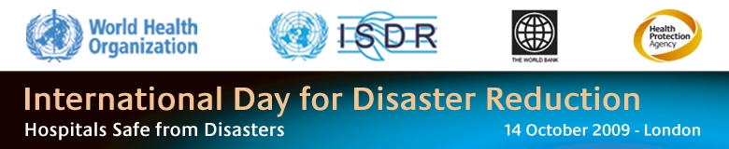
Europe

Slide 14
South East Asia

Slide 15


East Mediterranean
المستشفيات المأمونة من الكوارث الطبيعية
The 2005 Pakistan Earthquake destroyed 388 of the796 health facilities.
A Group of Experts was created to validate safe hospital assessment tools and to elaborate a Regional Implementation Framework.
Electronic Disaster Risk Atlas
At least 5 countries are implementing a safe hospitals initiative.

Slide 16
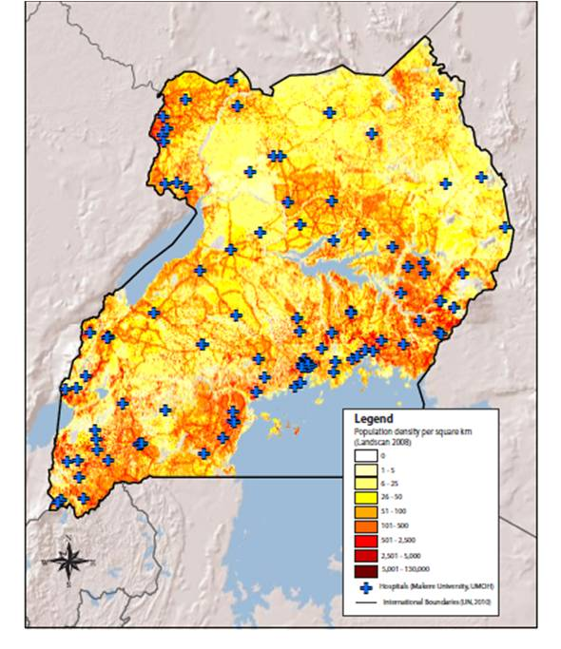
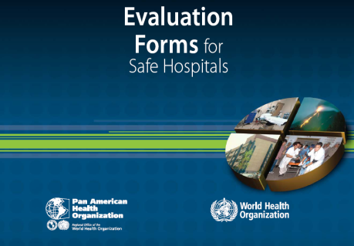
Africa:
Uganda experience
Health facilities / services
Vulnerability / Capacity
Missing health facility
Vulnerability / capacity information
Hospital Safety Index
Health Information System
Health facility registry

Slide 17

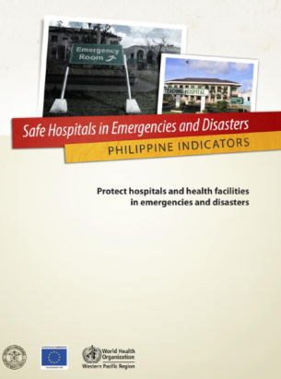


Western Pacific
Priority Actions:
Hospital vulnerability assessment.
Human resources for disaster management
Capacity building for preparedness and respones.
Technical cooperation to improve structural safety.
Workshops, training activities and tools to promote safe hospitals policy.

Slide 18
The Americas
Application of the Hospital Safety Index
Anguilla
Argentina
Bahamas
Barbados
Belize
Bolivia
Brazil
Chile
Colombia
Costa Rica
Cuba
Dominica
Dominican Republic
Ecuador
El Salvador
Grenada
Guatemala
Guyana
Honduras
Jamaica
Mexico
Montserrat
Nicaragua
Panama
Paraguay
Peru
Saint Kitts and Nevis
St. Vincent & the Grenadines
Suriname
Trinidad and Tobago
Uruguay
Venezuela

Slide 19
HSI results of the first 2945 hospitals assessed
Category A 51 %
Category B 37 %
Category C 12 %
Safety index | Category Type | What should be done?
0 – 0.35 | Category C | Urgent measures to protect the life of patients and hospital staff
0.36 – 0.65 | Category B | Necessary measures are required in the short term to reduce losses
0.66 – 1 | Category A | Preventive measures are required to maintain and improve safety

Slide 20

Smart Hospitals Initiative

Slide 21
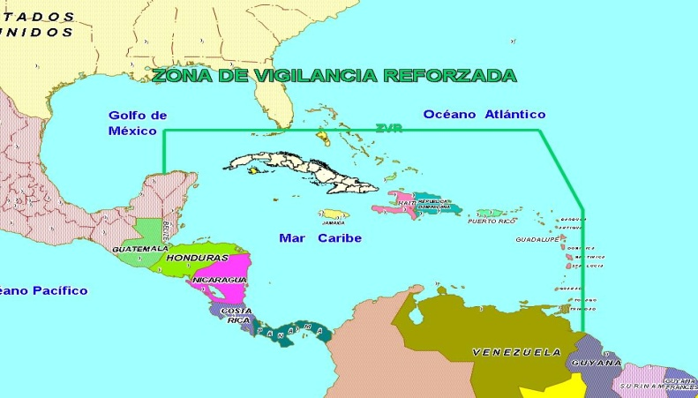

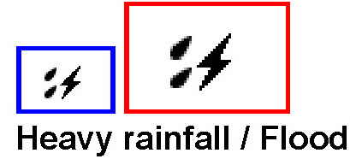

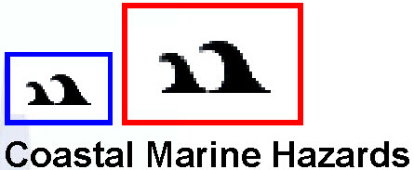
Consider Climate change as a hazard
21
INTENSITY
EXPOSURE IS INCREASING !
HAZARDS’ INTENSITY AND FREQUENCY ARE INCREASING
Do not wait for the right answer!
FREQUENCY
Dr.Jose Rubiera

Slide 22
Climate change impact on hospitals
Sea rise: 60% of the world population lives close to the sea
Extreme events: a 10% increase of wind speed
Carbon footprint: The England National Health Service accounts for 25% of total public sector emissions.
Energy: Brazilian hospitals use more than 10 % of the country’s total commercial energy consumption.
Chemicals: In the U.S., the health care sector is the single largest user of chemicals.

Slide 23
Aim of the Project
To develop resilient, climate-adapted and more sustainable health care facilities in the Caribbean region through the application of interventions aimed at reducing the vulnerabilities.

Slide 24
Project Deliverables
Annex to building codes in the region to guide the development of new healthcare facilities
Toolkit that allows for easy implementation of ‘safe’ and ‘green’ upgrades of existing health facilities
A Cost Benefit Methodology
A Policy that allows countries to integrate ‘smarting’ activities into their agenda.
Public awareness and capacity building tools and information
Two(2) demonstration projects.

Slide 25

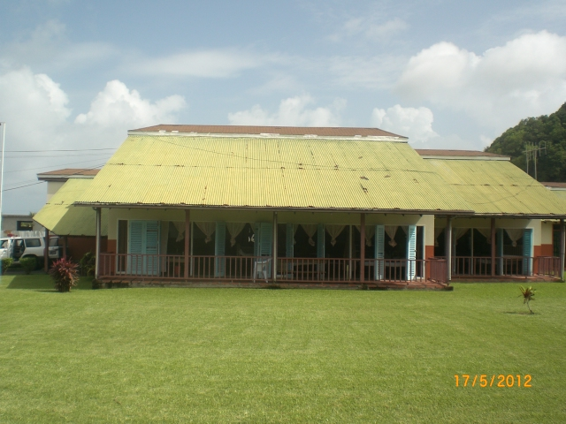
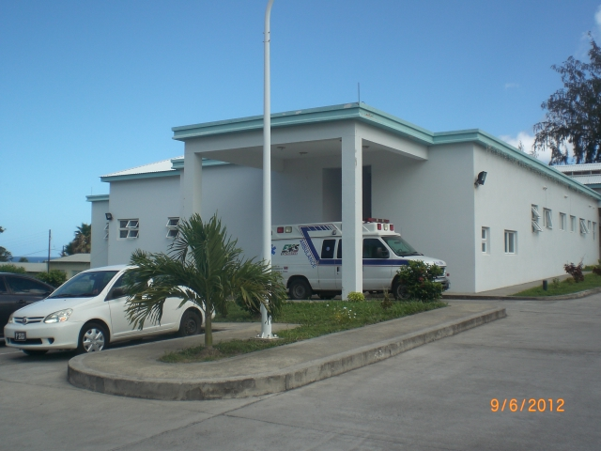
Demonstration Component
Implemented to allow for the practical application of the toolkit and allow for a better understanding of the constraints and achievements possible through this initiative.
Focused on Smart retrofits to both old and new Health care facilities
Two countries chosen; Georgetown Hospital in St. Vincent and Pogson Healthcare facility in St.Kitts
25

Slide 26
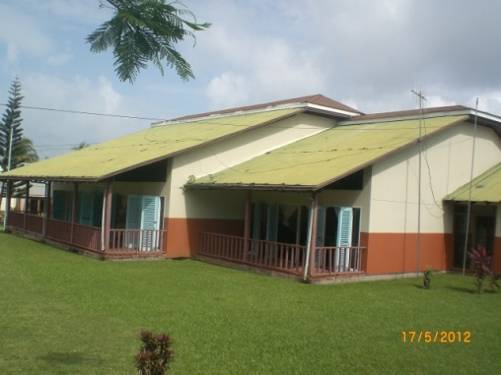
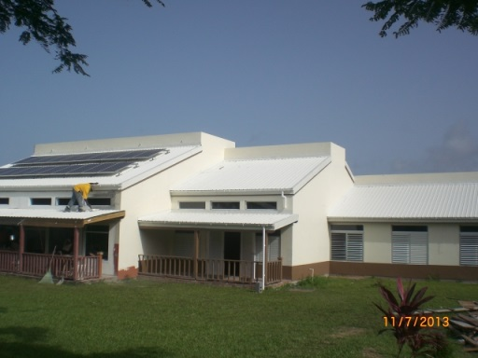
Demonstration Component
Georgetown Hospital (SVG) Retrofitting works completed:
Roof Works
Before
After

Slide 27
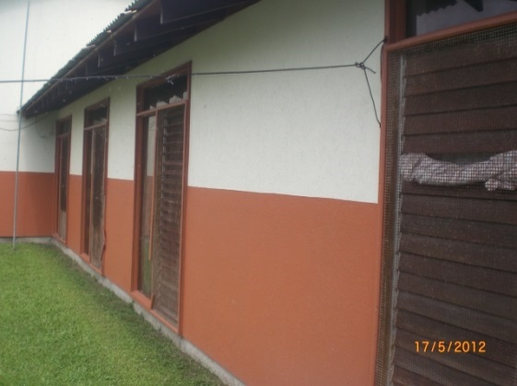
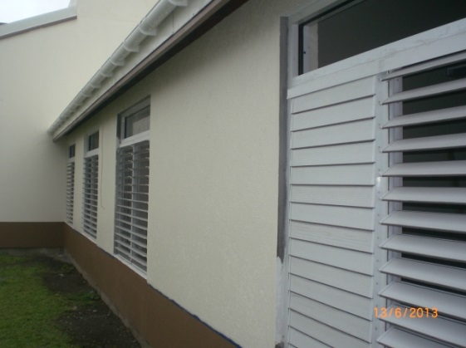
Demonstration Component
Georgetown Hospital (SVG) Retrofitting works completed:
Windows
Before
After

Slide 28
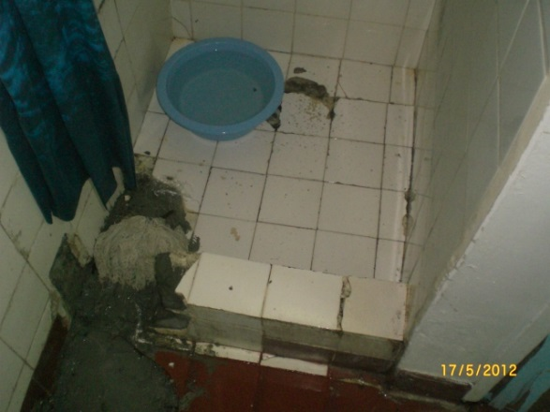
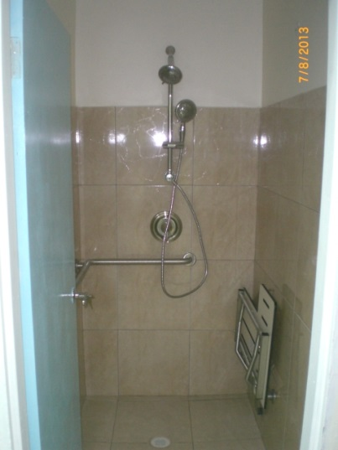
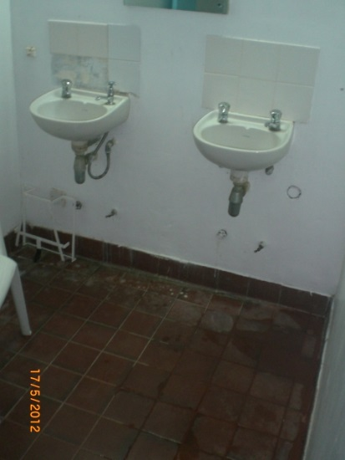
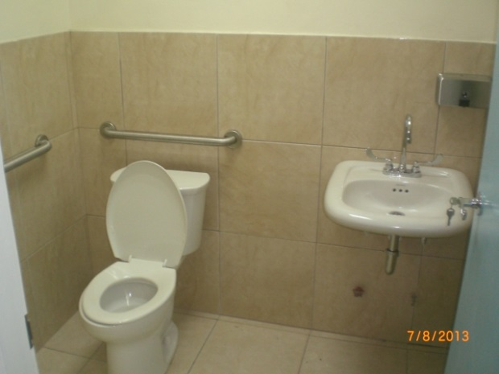
Demonstration Component
Georgetown Hospital (SVG) Retrofitting works completed:
Plumbing & Sanitary Fixtures
Before
After

Slide 29
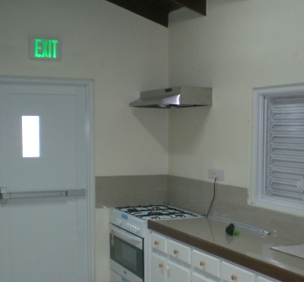
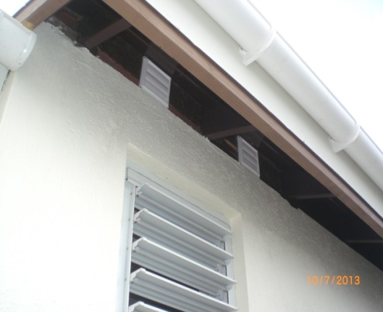
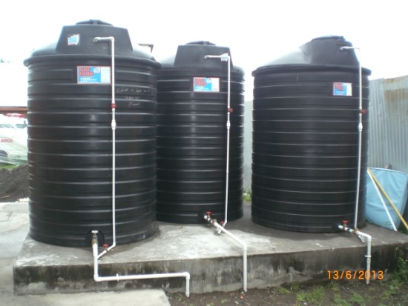
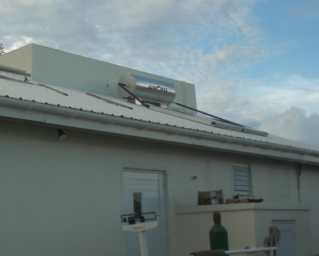
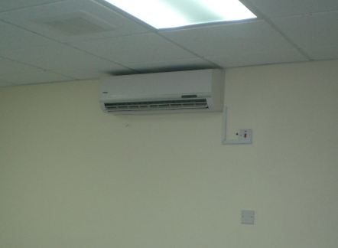
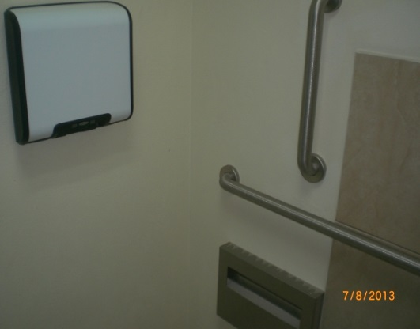
Demonstration Component
Georgetown Hospital (SVG) Retrofitting works completed:
Mechanical Works (Solar water heater, Exhaust fans, fans, water storage)
3,000 gal water tanks
Commercial Exhaust hood
Exhaust ceiling fan vents
80 gal solar water heater
18,000 btu a/c unit
Hand blowers

Slide 30
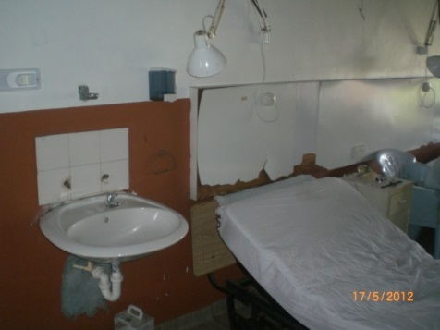
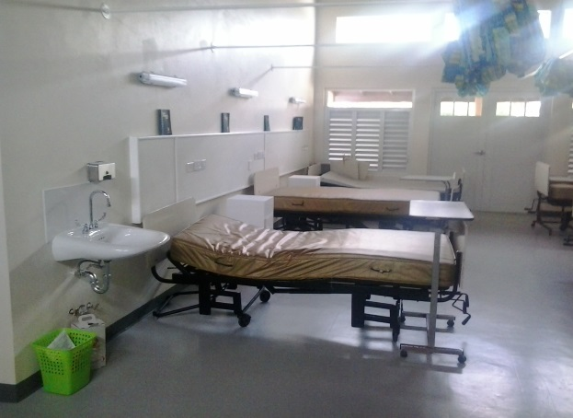
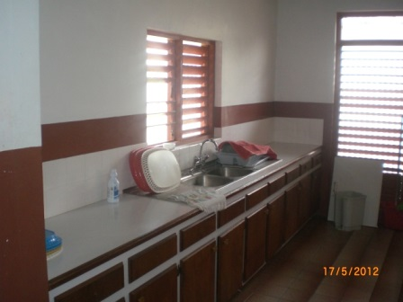
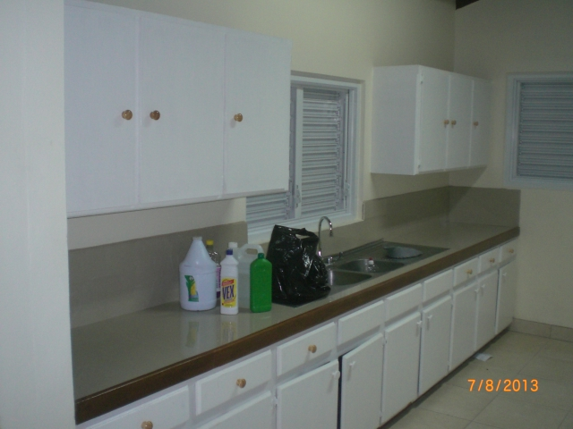
Demonstration Component
Georgetown Hospital (SVG) Retrofitting works completed:
Interior Furnishings (Countertop surfaces, wall headboards, cabinets, etc.)
Before
After

Slide 31
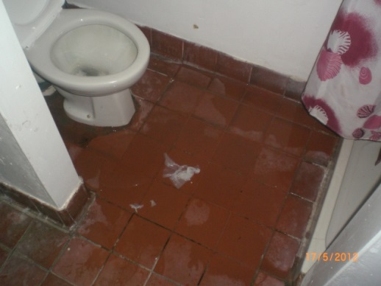
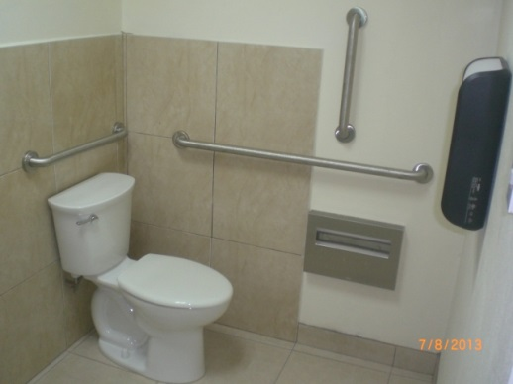
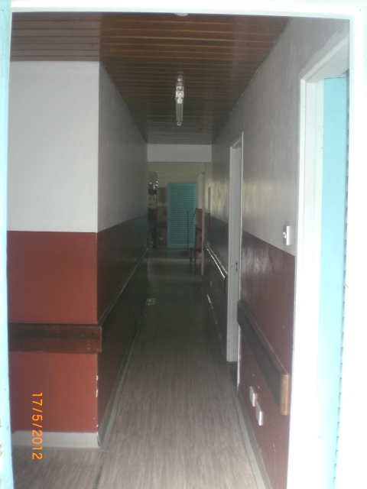
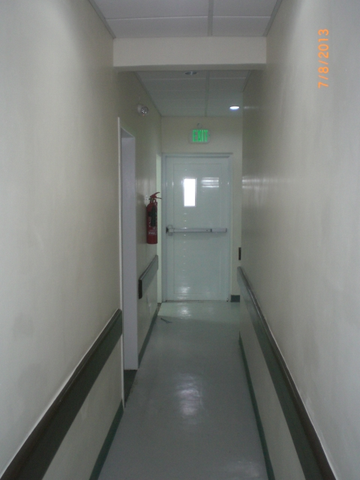
Demonstration Component
Georgetown Hospital (SVG) Retrofitting works completed:
Floor Finishes
Before
After

Slide 32

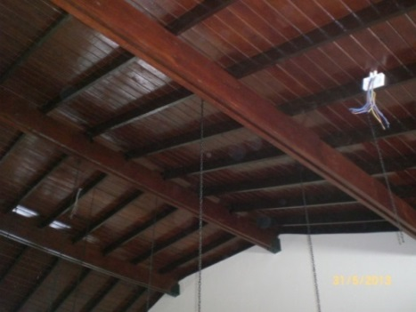
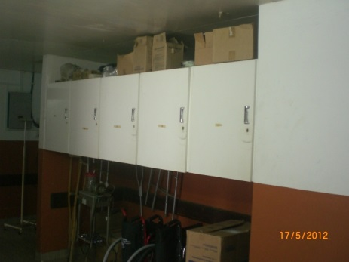
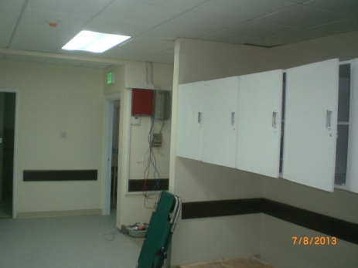
Demonstration Component
Georgetown Hospital (SVG) Retrofitting works completed:
Ceiling Finishes
Before
After

Slide 33

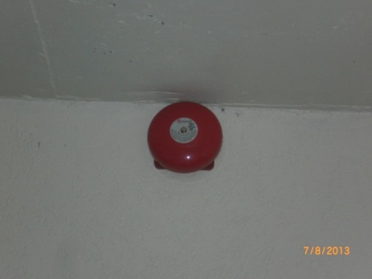
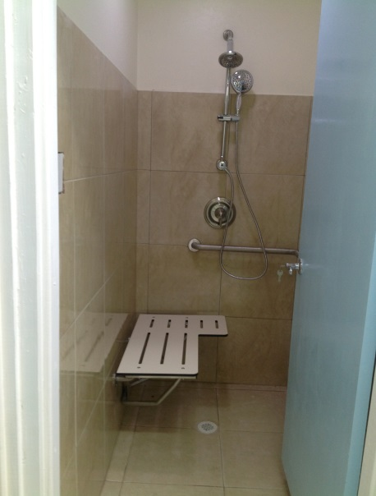
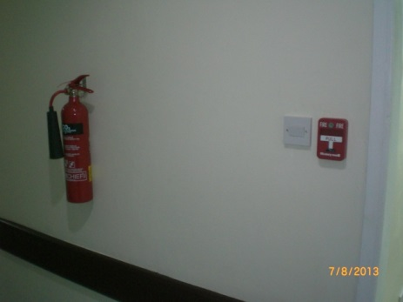
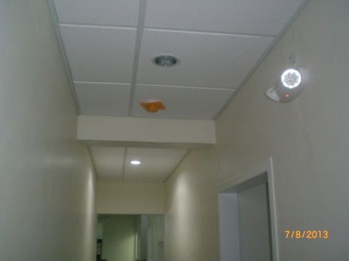
Demonstration Component
Georgetown Hospital (SVG) Retrofitting works completed:
Code Compliance (fire safety devices, grab bars, emergency lights)
Grab bars in restroom
Fire alarm bell
Folding shower seat and grab bars in shower stall
Fire extinguisher and pull station
Smoke detector and Emergency lights

Slide 34
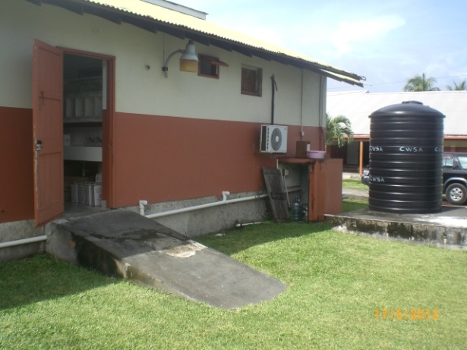
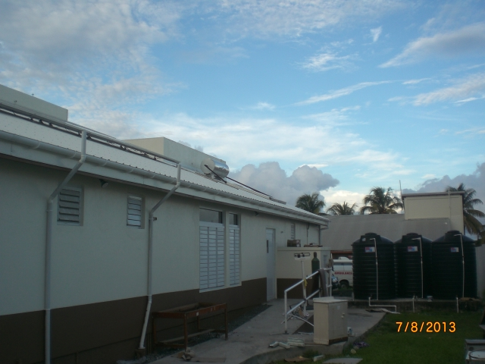
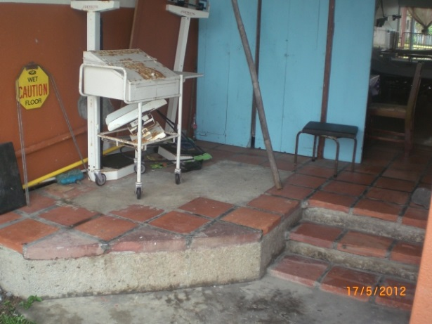
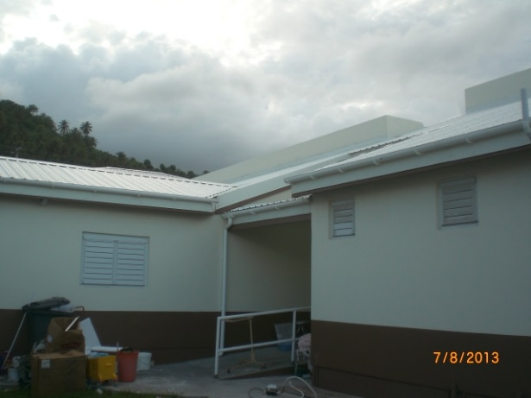
Demonstration Component
Georgetown Hospital (SVG) Retrofitting works completed:
External Works
Before
After

Slide 35
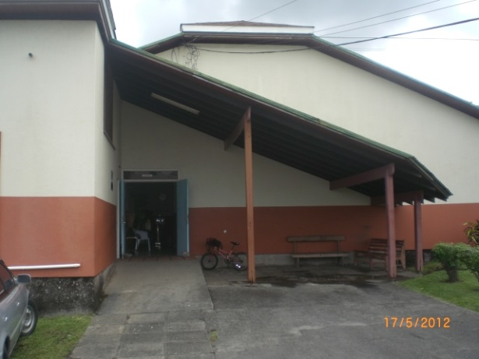
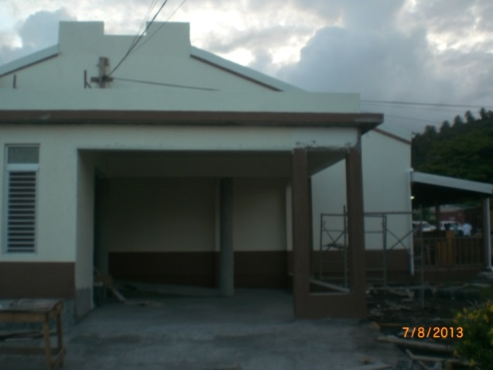
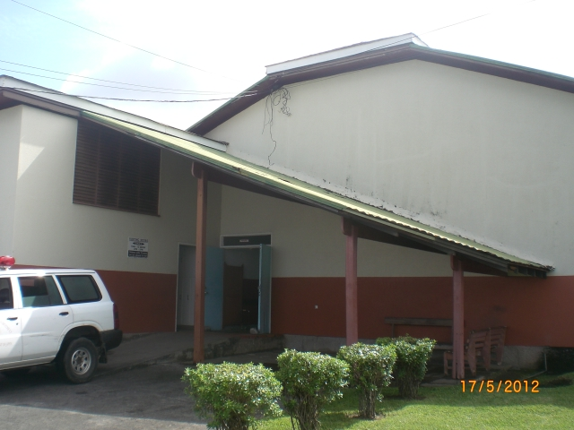
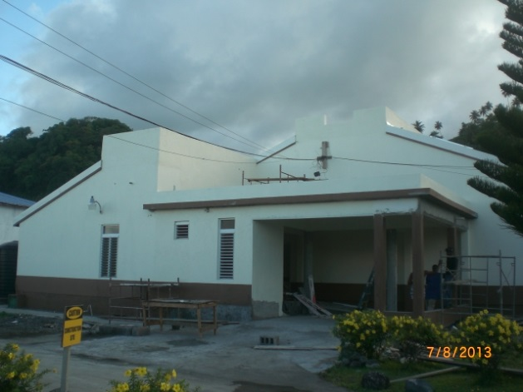
Demonstration Component
Georgetown Hospital (SVG) Retrofitting works completed:
Main Entrance Works
Before
After

Slide 36



Demonstration Component
Progress of Georgetown Hospital (SVG) Retrofitting:
Project was officially completed on July 31, 2013
Final project cost was US$345,926.35 in 18 weeks.
Official handover of the facility to the Government of St. Vincent on September 07th, 2013.

Slide 37
Outcomes
Project well received and supported by the community and Friends of the Georgetown Hospital.
All aspects of the retrofitting works were completed within specifications and by local & international Safe Hospitals standards
Average energy consumption/month is 3,570 kw/hr. Later official meter reading was 1,166 kw/hr.
Facility has shown a confirmed energy reduction by as much as 64% and an average of EC$1,849.00 in cost savings.
Patient increase by 34%

Slide 38
The Testing Phase
Heavy Rains impacted SVG on 24th December 2013
No impact to Georgetown Hospital
Hospital beds were full and facility was able to provide continuous health services for the community
Water storage systems were connected and served a large portion of the population who had no water
Back up power supply functioned well
All systems were fully tested and worked well

Slide 39
Smart Hospitals are green and safe
Improving the structural safety of health care facilities;
Reducing energy and water use;
Boosting energy security with low carbon, renewable sources;
Improving air quality and reducing harmful emissions;
Strengthening disease surveillance and control;
Equipping structures with efficient and environmentally friendly appliances and fixtures.

Slide 40

A Model Policy for
SMART Health Facilities

Slide 41

SMART Hospitals Toolkit

Slide 42


Slide 43
.
.
Ensuring health services function in emergencies
Dr. Ciro Ugarte
Director
Emergency Preparedness
And Disaster Response

